Slide 1




Eco-friendly Tourism: A Sustainable Approach
Eco-friendly tourism is a responsible approach that minimizes the environmental impact of travel. By choosing sustainable accommodation, transportation, and activities, tourists can enjoy incredible experiences while preserving natural habitats and supporting local communities.
SR
by Shashi Reddy

Slide 2


The Importance of Sustainable Travel
Conserve Natural Resources
Support Local Economies
Sustainable tourism reduces waste, protects ecosystems, and preserves the environment for future generations.
Eco-friendly travel benefits local communities by providing jobs and income, empowering residents to preserve their culture.
Enhance the Experience
Sustainable tourism offers unique, authentic experiences that allow travelers to connect with the destination in a meaningful way.

Slide 3
Eco-lodges and Sustainable Accommodations
Eco-lodges
Green Certification
Authentic Experiences
These environmentally-friendly hotels use renewable energy, recycle waste, and employ local staff to minimize their carbon footprint.
Many eco-lodges and hotels are certified by independent organizations to ensure they meet high sustainability standards.
Staying at an eco-lodge immerses travelers in the local culture and provides opportunities to learn about conservation efforts.

Slide 4


Eco-friendly Transportation Options
1
Walking and Biking
2
Public Transportation
Exploring a destination on foot or by bicycle reduces emissions and allows for a more immersive experience.
Using trains, buses, and ferries instead of private vehicles minimizes the carbon footprint of travel.
3
Electric Vehicles
Renting or using electric cars and shuttles for transportation is a clean and sustainable choice.

Slide 5





Responsible Wildlife Experiences
Ethical Observation
Observe wildlife from a distance, avoiding any disturbance to their natural behavior and habitat.
Guided Tours
Book tours with reputable, eco-conscious operators who prioritize conservation and animal welfare.
Sustainable Activities
Participate in activities like birdwatching, nature walks, and marine life encounters that minimize impact.

Slide 6





Preserving Local Cultures and Traditions
Support Local Artisans
Purchase authentic handicrafts and souvenirs directly from local artists and craftspeople.
Experience Cultural Events
Attend festivals, performances, and ceremonies to immerse yourself in the destination's unique customs.
Responsible Interaction
Interact with locals respectfully, learn about their way of life, and avoid exploitative practices.

Slide 7

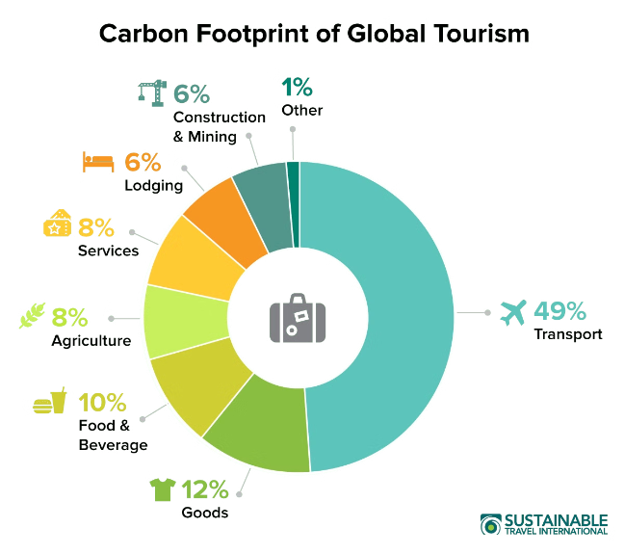
Reducing Carbon Footprint in Tourism
1
Offset Emissions
Invest in carbon offset programs to counterbalance the environmental impact of your travel.
2
Minimize Waste
Reduce plastic use, recycle, and properly dispose of waste to avoid contributing to landfills and oceans.
3
Support Sustainable Businesses
Choose eco-friendly accommodations, restaurants, and tour operators that prioritize sustainability.

Slide 8


Eco-tourism Certification and Standards
Certification
Description
Green Globe
Recognizes sustainable tourism practices and environmental management systems.
LEED Certification
Ensures green building design, water efficiency, and energy conservation in accommodations.
Rainforest Alliance
Promotes sustainable tourism that benefits local communities and protects natural resources.

Slide 9


The Future of Sustainable Tourism
Innovation
Responsible Travelers
Emerging technologies and sustainable practices will continue to drive the evolution of eco-friendly tourism.
Increased awareness and demand for sustainable travel will encourage more destinations to prioritize sustainability.
Balanced Approach
The future of tourism will balance environmental protection, economic development, and cultural preservation.

